Slide 1
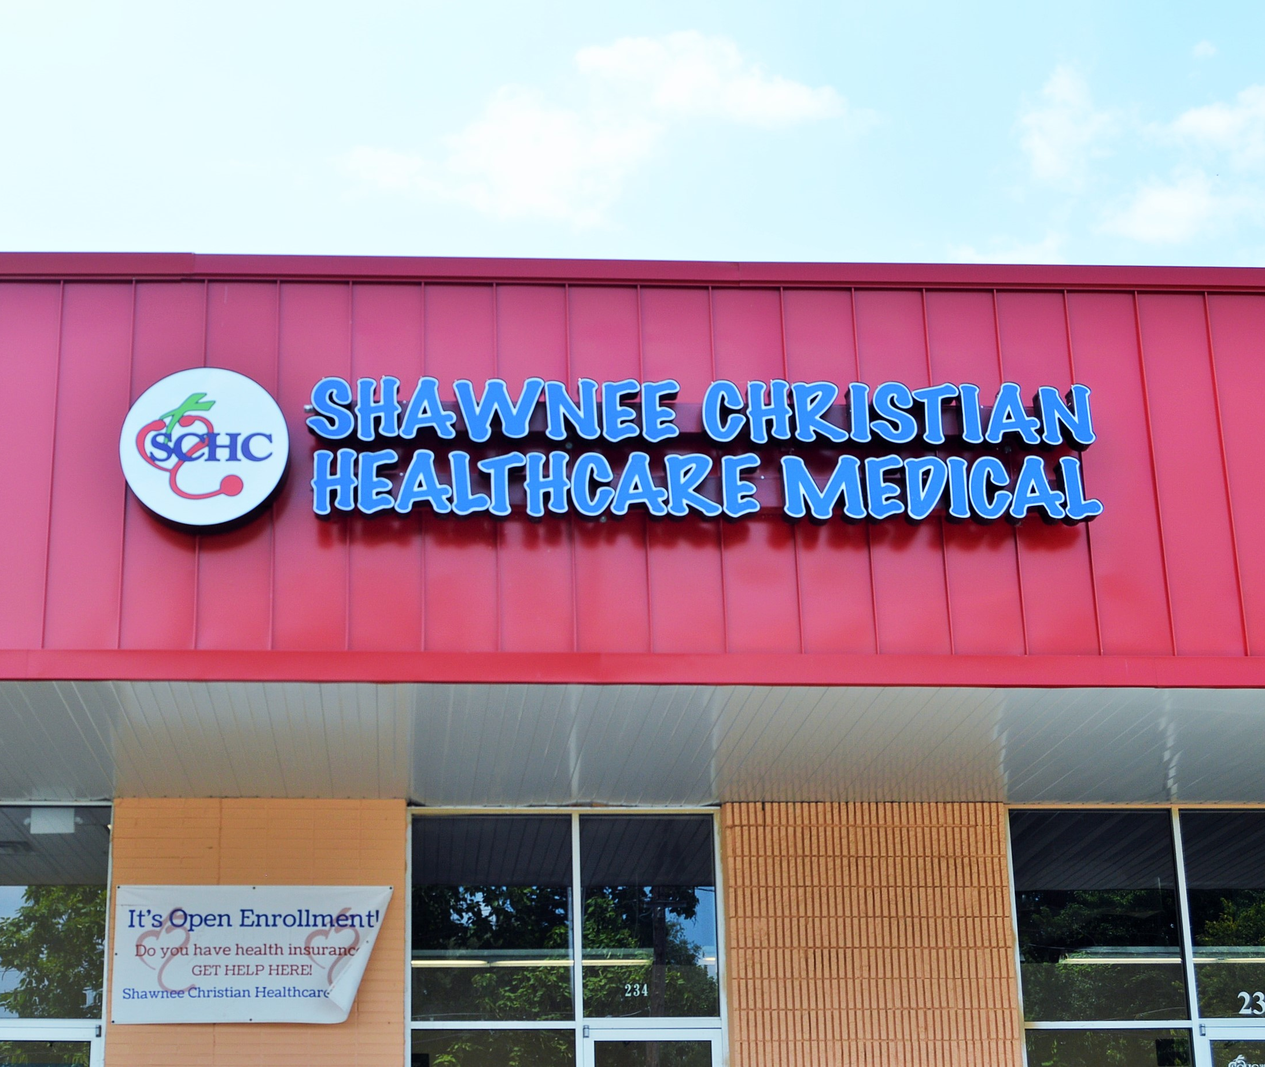
KYACHW 2020 CONFERENCE
Celine Mutuyemariya
Community Health Coordinator
Shawnee Christian Healthcare Center

Slide 2
How has COVID-19 impacted your organization?
Telehealth
No home visits
Remote support
Organizational changes
More time spent in the office rather than the community
Self-care

Slide 3
How has COVID-19 impacted you as a CHW?
Has your role changed? What are you doing now?
Crisis management
Advocacy
Creative thinking
Partnerships are key
Linkage to support/resources to address the tech divide

Slide 4
What challenges have you seen as a result of COVID-19?
Digital divide as a barrier to care and community engagement
Decreased engagement in chronic disease self-management
High stress levels for self and family
Increased isolation
Decreased financial security

Slide 5
What successes have you had?
Training to support patients with digital inclusion
Partnership with Dare to Care for food pantry
Partnership with SOS for toiletries
Dare to Care community kitchen for socially distant health education classes
Medicaid waiver programming has helped patients who are seniors and disabled get help at home and respite support
Housing advocacy and resources navigation

