Slide 1

CHW Health Insurance Literacy Outreach and Resources
Kentucky Association of Community Health Workers Conference
September 27, 2018
Liz Edghill, BA, RN, BSN, Manager of Refugee and Immigrant Services
Community Health Worker Program Supervisor
Notes:
Today’s presentation can be used Application Assisters, Community Health Workers, ESL teachers, Adult Education teachers, Health Educators, etc. Think about this as information that may help you and your friends and neighbors…and as a resource for your toolkit in your job as well.

Slide 2





ACA
“Repeal and Replace!”
What is “Obamacare” anyway?
I don’t have Medicaid; I have Passport!
Is the Markplace still there?
Notes:
I’m sure you have heard of “Obamacare.” Remember Kynect? What have your heard about “Repeal and Replace”?
Obamacare, or the Affordable Care Act, isn’t a type of insurance. It is a group of laws that try to make it easier for people to get health insurance that will help keep them healthy, and to help them when they are sick. In Kentucky, we used the ACA to expand Medicaid.
Health Insurance Literacy includes knowing what type of health insurance coverage is available and what programs one might be eligible for. This is confusing when we have different names for them! And when insurance providers may vary by state or by region.
------------------------------------

Slide 3
What are the top KY HEALTH questions consumers are asking?
Do we still pay our premiums?
Do we still pay co-pays? (per procedure or per visit)
What’s a State Plan? (confused on language in letters)
Do I still participate in PATH?
Do I still have dental/vision?
Notes:
These questions came out of a meeting of application assisters in September 2018 as their most frequently asked questions about KY HEALTH

Slide 4
Top questions/concerns consumers voice about health insurance in general
Is marketplace still going to be there?
Will I have to pay a fine this year if I don’t have insurance?
Overall confusion when consumers transfer from Medicaid to a Qualified Health Plan (QHP)
  Basic understanding of paying a premium each month
  Copays when going to doctor, etc.
Healthcare.gov notices are confusing
Notes:
These questions came out of a meeting of application assisters in September 2018 as their most frequently asked questions about health insurance

Slide 5


CHWs can help people increase their Health Insurance Literacy

Slide 6
Sharing the basics
Understand key insurance terms
Review your plan to see what
services are covered.
Understand your out of pocket costs.
Know the difference between in-network and out-of-network.
Notes:
We don’t need to know every detail, but it’s good to understand what services are covered, and how much we can expect to pay when we get care. Most importantly, we need to know where to find this information when we need it.
Your insurance provider and even your insurance card should be able to help you understand the exact cost of your premium, copay, and deductible.
A set of terms you’ll see on this slide is in-network and out-of–network. In-network means a provider work with your health plan and it will cost you less to see them rather than an out-of-network provider. Your plan keeps a directory of providers who are in-network. You can generally find it on the plan’s website, or you can request a copy.
Managed Care Organizations (MCOs) for Medicaid have networks too

Slide 7

Cost Sharing = costs that you pay
Explaining Health Insurance Terms
Notes:
Before you can make a good decision about which insurance plan to choose, and in order to use your coverage well, there are some basic terms that you will need to know. Many of the terms relate to cost sharing. Even when you have insurance, you will still have to pay some costs.
KY HEALTH uses this phrase “cost sharing” as well.

Slide 8
Explaining Health Insurance Terms
Premium is a payment made, usually monthly, to an insurance company for your coverage.
Deductible is the amount you owe for health care services before your plan will start paying for your care. Note: May not apply to all services.
Copayment (Copay) is a fixed amount you pay for a covered health care service or supply. For example, $15 for a provider visit.
Coinsurance is your share (a percent) of the costs of a covered service. For example, if your coinsurance is 20%, and the service cost $100, you pay $20.
Notes:
(Use these slides if video is not available)
Let’s take some time to go over some of these key words.
Premium are payments generally made every month to your insurance company to maintain coverage. It’s important to pay your premium, regardless of whether they use any health care services. This will ensure you keep your coverage.
-With private insurance, you pay some money every month. This is called a premium.
-If your insurance is through your employer, this may be taken out of your paycheck.
-If you purchase a plan, you may receive a bill in the mail. You must pay each month, or you may lose your coverage.
-Some Medicaid members will need to pay premiums if changes take place here in Kentucky.
Deductible is the dollar amount consumers have to pay for health care services before their plan will start paying for their care. The deductible may not apply to all health care services. For some plans, you do not need to pay the deductible before your plan will pay for primary care or prescription drugs. Deductibles differ by plan, so look through your insurance information to see what yours is. You should also keep track of how much you’ve paid toward the deductible. Each year, your deductible is reset.
-The amount you owe for health care services before your health insurance plan begins to pay.
-Deductibles vary by plan, so you will want to learn about them when you are choosing new health insurance.
Copayment (or Copay) is the fixed amount you’ll pay for a covered health care service or supply. Copayments are usually a set amount, for example $15 for primary care visits and $35 for specialty care visits. The amount of the co-pay will differ based on the type of care or service. Some services won’t have a copay, such as preventive services. Medicaid members may also have to pay small copays for some services.
-You will also have to pay a copay when you visit the doctor or get a prescription. Private insurance copays are usually higher than Medicaid MCO copays.
-You will pay a higher copay if you go to a specialist or urgent care center than if you see your family doctor (PCP).
-If you go to the emergency room at the hospital, there is a higher copay, and you may be charged a lot of money if it is not actually an emergency
Coinsurance is the consumer’s share of the costs of a covered health care service. For example: if the cost of a visit to a specialist is $100, and the consumer is responsible for paying 20% coinsurance, he or she would pay $20.

Slide 9

Video:
Understanding Your Health Insurance Costs
https://www.consumerreports.org/video/view/healthy-living/health-insurance/3957094726001/understanding-your-health-insurance-costs/
Or https://www.youtube.com/watch?v=DBTmNm8D-84
Notes:
This Consumer Reports video does a nice job of explaining basic health insurance terms and how cost-sharing works.

Slide 10



From Coverage to Care (C2C)
Visit http://marketplace.cms.gov/c2c
Print copies are available for free.
Notes:
These booklets were created with the Affordable Care Act to help people, many of whom had never had health insurance before, know how to navigate the health care system and understand how to use health insurance. Most of the content still applies and we’ll use some of it throughout this presentation.
From Coverage to Care was started by the Centers for Medicare & Medicaid Services (CMS). It was designed to help individuals understand their health coverage and connect with the primary care and preventive services that are right for them so they can live long, healthy lives.
A number of resources have been created through C2C, the main one being the Roadmap to Better Care and a Healthier You, which we will focus on today. You can order copies for free in seven languages other than English, and view other resources such as videos by visiting marketplace.cms.gov/c2c. These are available online but also in print copy.
NOTE: (Other languages = Spanish, Chinese, Arabic, Haitian Creole, Korean, Russian, and Vietnamese. These languages represent the most frequently requested languages to the Marketplace Call Center, and the languages with the highest percentage of speakers with limited English proficiency among the top languages spoken at home other than English across the country.)

Slide 11



Getting creative with explanations and visuals
$
$
Your Money
Your Bill
No Insurance
Notes:
(Use these slides if video is not available)
This visual representation may be something that will help the concepts of cost-sharing stick in your mind, or could be an activity to do with clients and community members to help them understand.
Here is a review– this is what happens when you have no insurance.

Slide 12


$2,000
Insurance Money
$
$
$1,500
Deductible
Your Money
$500
Notes:
(Use these slides if video is not available)
When you have private insurance, there is often a deductible. That is the amount of your own money that you have to pay before the insurance will start to pay for covered services.
For example, if the deductible is $500, and you have a $2000 bill, you will pay $500 and your insurance will pay $1500.
The deductible does not include the premium that you pay each month, or copays you pay at each visit or when you pick up a prescription.
Deductibles start over again every year.

Slide 13


Insurance Money
$
Coinsurance
Coinsurance
Your Money
Notes:
(Use these slides if video is not available)
Some insurance plans also have “coinsurance.” After you meet your deductible (click), you still have to pay a percentage of medical bills as coinsurance (click), until you reach an “out of pocket” maximum.
This is a very simple explanation, so it’s very important to understand your options when you go to buy insurance. If you get insurance benefits through your employer, you can talk to HR about your plans. If you think you employer plan is too expensive, bring the plan information to an application assister. They can help you compare your employer’s plan to plans on healthcare.gov. If your employer plan is too expensive, you may be eligible for discounted plans on healthcare.gov.
There are also some services that do not count towards your deductible. This may include routine doctors visits, or cancer screenings. This is another reason to make sure to understand your plan.

Slide 14
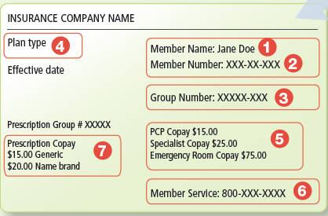
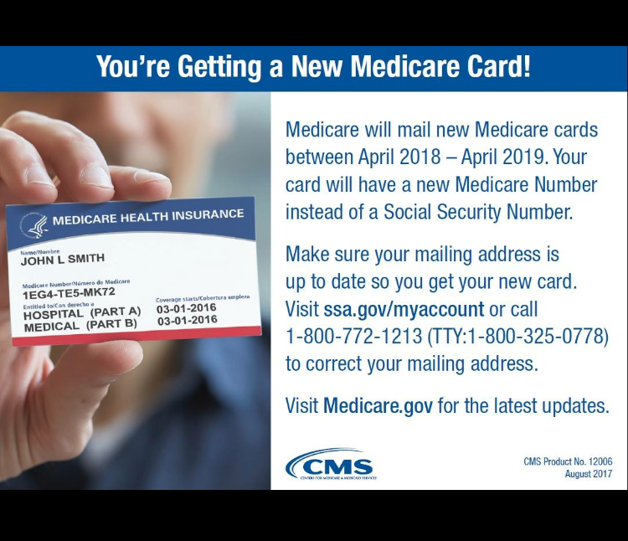
Getting familiar with Insurance Cards
Key terms
1) Member Name
2) Member Number
3) Group Number
4) Plan Type
5) Copayment
6) Phone Numbers
7) Prescription Copayment
Notes:
Audience Participation
Let’s pull out our insurance cards, if you have yours available, and see if we can identify the information listed. You’ll see where it has your name and the plan information, the member number, group number, plan type. Do you see the amount for your co-pay for a primary care visit? Or prescription? Does your card show how much your deductible is?
Next, turn your card over. Usually this is where your plan’s contact information is located. If you have questions about your coverage or a claim, call that number for help. Can everyone find their plan’s contact information?
______________________________________________________________________________________________________
(Page 12 of From Coverage to Care: A Roadmap to Better Care and a Healthier You) This slide shows what an insurance card might look like. You can actually have this information on its own handout from Coverage to Care, if it helps you. A few key terms are highlighted.
While we are thinking about insurance cards and personal information, this is a good time to remind you not to share your insurance information with anyone and to keep it in a secure location.

Slide 15

Giving reminders on when to use that card!
When making an appointment for medical, dental, vision, or mental health services
When signing in at the provider’s office
In the exam room
At the pharmacy
When using an ambulance or emergency services
When you have a question about coverage, call the member services number
Notes:
When making an appointment for medical, dental, vision, or mental health services – tell the office what kind of insurance you have and see if they accept it.
When signing in at the provider’s office – make sure they have the most up to date billing and insurance information on file.
In the exam room – let your provider know what type of coverage you have; It may help them determine the next steps, affordable meds, and referral options.
At the pharmacy – they need up to date billing and insurance information; Sometimes they can work with your provider and the insurance company to advocate for the right medicines for you.
When using an ambulance or emergency services – these times can be stressful, but you should always have your insurance cards with you.

Slide 16
CHWs can coach on how to choose Health Insurance

Slide 17
Source: Quincy, L. (2017). How can we make insurance shopping better for consumers? KVH Annual Conference.
Notes:
Choosing health insurance is confusing – that’s why we are here today! This is what it feels like for many people – a foreign language with some important numbers thrown in.
Healthcare.gov has some helpful plan comparison tools, but you may need to help clients get thinking about key considerations.

Slide 18
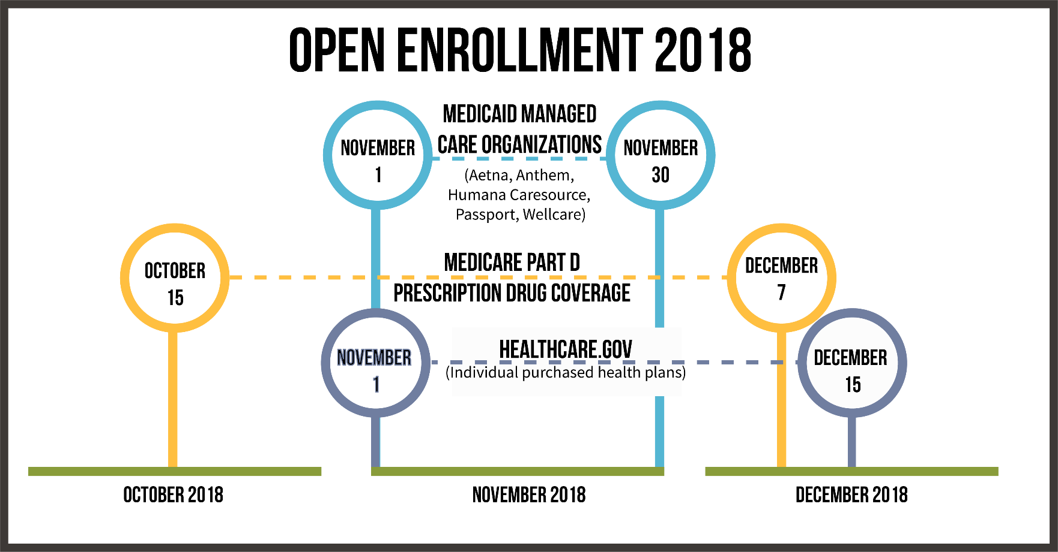
Spread the word about open enrollments
Notes:
Part of assisting clients in choosing the right health insurance is understanding what they may be eligible for and when. (Employer based coverage may only be available during an initial period after employment or during an annual open enrollment period).
This example shows the complexity of health insurance, too.
Kentucky Voices for Health developed this graphic to explain this fall’s open enrollment periods in plain language…because Medicaid, Medicare, and Qualified Health Plans all have different open enrollment periods and “open enrollment” means different things for each program.

Slide 19

Linking to Health Insurance Expertise
Application Assisters
Department for Community Based Services (DCBS)
Human Resources
SHIP contacts
Insurance is complicated, but there are people who can help you find the insurance that’s right for you.
They can help you find out if you are eligible for Medicaid and help you apply.
They can also help you understand other health insurance options and help as you apply for a plan.
Notes:
If you are not the person trained to help folks enroll in health insurance, make sure you have your community resources ready. It may be good to meet local application assisters or shadow them.
Emphasize with clients that Application Assisters in the community are there to help people understand these decisions; the assistance is free.
Remind clients that if they get health insurance from their employer, the Human Resources department may be able to help answer questions.
Remind folks that if something in the family chances (you lose your job, you have a new baby…), then eligibility for Medicaid might change. They can go to an application assister for help.

Slide 20
Notes:
Just this week, Medicaid members may have received a brochure along with other information about choosing MCOs.
It mentions the hospital and provider networks and then suggests asking yourself with MCO offers extra benefits at no cost (contact your MCO for details)

Slide 21
Sharing points for consideration
Provider Network – does the plan include the provider and specialists you already see?
Covered Services – does the plan cover the services you need? If there are copays for these services, would they be affordable to you?
Medications – does the plan’s formulary list include the drugs that you use and need? If there are copays for these medications, would they be affordable to you?
For Medicaid MCOs, are there incentives that would be helpful to you?
Notes:
While costs may be top of mind for many people, when choosing health insurance, we need to think about the adequacy of the coverage too. Would the out-of-pocket costs be affordable, are our current providers or specialists in the network? If we need physical therapy or a chiropractor, how many sessions are covered? If I hope to get pregnant this year, is the hospital I like in network? Are my medications covered?

Slide 22

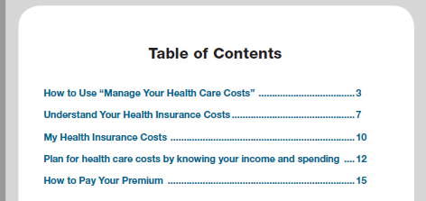
https://www.cms.gov/About-CMS/Agency-Information/OMH/Downloads/Manage-Your-Healthcare-Costs.pdf
Notes:
This resource is available as an online tool and printed copies are available for order from CMS.

Slide 23
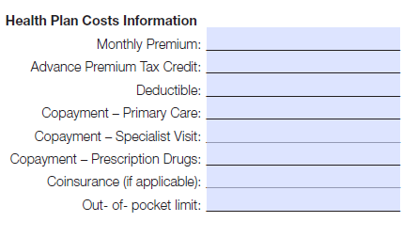
Costs to Consider
https://www.cms.gov/About-CMS/Agency-Information/OMH/Downloads/Manage-Your-Healthcare-Costs.pdf
Notes:
When someone is eligible for a tax credit, how do you walk them through that? Expertise from the room

Slide 24
CHWs can Coach on Using Health Insurance and Keeping Covered

Slide 25
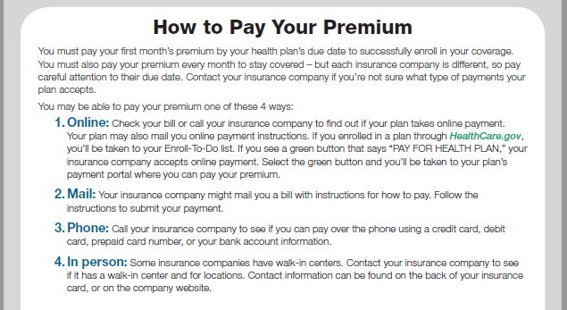
Explaining Payment Options
https://www.cms.gov/About-CMS/Agency-Information/OMH/Downloads/Manage-Your-Healthcare-Costs.pdf
Notes:
It will be important to remind people that they must pay their premiums even when they do not plan to use the health insurance coverage – this is not a natural concept! Remind them of other types of insurance – auto and car…. We must pay for those “just in case” times too.
Most insurance plans will have a variety of payment options. The importance of paying premiums and paying them on time cannot be emphasized enough.
With potential Kentucky Medicaid changes, many Kentuckians will be required to pay monthly premiums – this is new for the program and will be new to the Medicaid members!

Slide 26
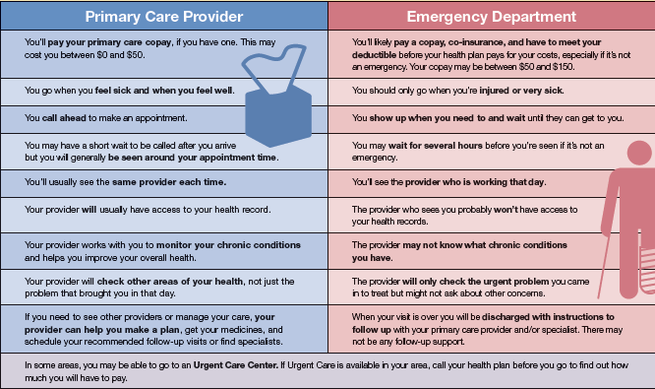
Explaining Levels of Care:
Primary Care vs. Emergency Care
Notes:
In your Roadmap (page 18 in your booklet) you’ll see a table that highlights some of the differences between primary care and emergency care. This table is also available as its own handout from Coverage to Care.
One of the first things to note is that if you use the emergency room for a non life-threatening illness or injury, you will likely pay more. Typically, the co-pay for an ER visit is higher than for a primary care visit.
Another difference is that you can call for an appointment with your primary care provider. But in the ER you will wait to be seen based on the severity of your condition and the seriousness of the other people waiting.
When you see your primary care provider, they’ll get to know you and your health history, and can be able to access your health records. At the ER, they will not be able to look at your health records.
Many people will ask about urgent care as well. I’m sure many of you have seen an urgent care center. Urgent care is care for an illness, injury or condition serious enough that a reasonable person would seek care right away, but not so severe it requires emergency room care. Urgent Care Centers may offer more accessible hours than a primary care provider and seem more accessible than an ER. But you’ll want to check with your plan about what this may cost. You may also need to make sure it is a standalone Urgent care center and not actually part of the ER, which would cost more.

Slide 27
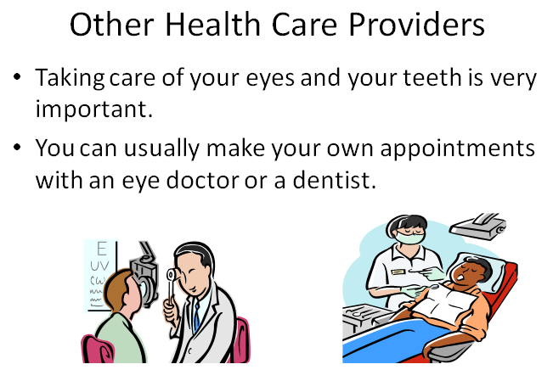

Linking to Vision & Dental Services
Keep up with the latest on Medicaid coverage for these services.
Find in-network providers.
Note –children’s benefits may be different than their parents.
Notes:
Discuss limited coverage of health insurance for these services. Medicaid may cover eye exam but not necessarily glasses. Will pay for children to have teeth cleaned twice a year; adults once per year.
Direct to community resources for lower cost glasses and lower cost dental services.
Discuss opportunity to purchase additional, optional vision and dental coverage when working. (Upcoming changes to Medicaid for Dental and Vision?)

Slide 28
Medicaid - Getting the most out of your health insurance coverage now
Good health is always important. Take advantage of your health insurance coverage now:
  Schedule Dental and Vision visits
  Schedule a visit with your Primary Care Provider (PCP) for any health concerns, routine check ups, preventive screenings or lab tests. You can start earning “My Rewards” dollars now for preventive screenings.
  Referrals to specialists can take a while – start the process now.
Notes:
Specialist referral “next available” appointments for new patients can be 1-3 months away. Act sooner than later!
Preventive Dental appointments now can earn you points for My Rewards
Preventive exams like Well Child Checks and annual visits can earn My Rewards points now too

Slide 29
Medicaid - Getting the most out of your health insurance coverage
You can earn some benefits, like Dental and Vision, by participating in approved activities.
Earn credits with things like:
  Health and Finance classes
  Preventive screenings
  Health visits
  Work or Career building classes or activities
  Educational activities

Slide 30
Avoid gaps in coverage
Pay premium as soon as approved for coverage.
Pay premiums on time.
Confirm your coverage is active each month.
Keep information up to date.
Notes:
These tips are true for all health insurance coverage types and may be even more important if KY Medicaid changes go through. Help clients avoid suspensions and lock-outs.
Pay Premium as soon as approved for coverage. Your Insurance won’t start until the 1st Premium is paid.
Pay Premiums on time. Fast Track Option allows members to pay in advance up to a full year!
Confirm your Insurance coverage is active. Even if you don’t have an upcoming medical visit scheduled, doing this monthly will help keep coverage for unexpected medical needs or emergencies.
Keep information up to date. ANY change in income, household size or other eligibility requirements MUST be reported within 30 days. If in doubt, call benefind or an Assister!
Some community organizations may be able to help pay premiums, if you are ever in a situation where you don't have the ability to pay. Every community will do this differently, so be sure to ask your refugee agencies, your health care provider, or an application assister for more information if you are having trouble paying the premium.
Lock-Out/DisEnrollment Errors: Even if an error occurs, it can take several weeks to correct & back coverage is not guaranteed.

Slide 31

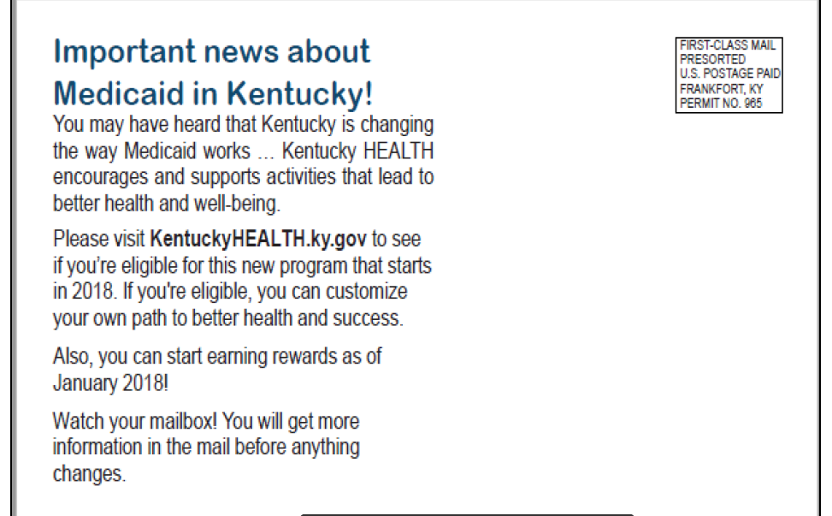
Keep aware of Medicaid notices and mailings

Slide 32


Staying up-to-date:
Follow Social Media

Slide 33
CHWs can Empower Your Community…
With the knowledge to make informed health insurance decisions
With up-to-date information about healthcare system changes
With simplified health insurance explanations
With application and navigation assistance
With materials and programs to improve Health Insurance Literacy
With ways for them to communicate stories and experiences to policy makers at state and federal levels

Slide 34
Resources
Order resources
http://marketplace.cms.gov/c2c
See the State’s updates and FAQs about Kentucky HEALTH
https://kentuckyhealth.ky.gov
See Kentucky Voices for Health resources and join their mailing list
https://www.kyvoicesforhealth.org/
Notes:
Have information available about these topics:
Health Education classes and resources
Application Assisters in the community
Help for Medicare questions
Health centers and dental clinics with sliding fee discounts
General health literacy good practices – medication lists, information about MedlinePlus, tips for asking questions, etc.
You can also download or order the Roadmap that we discussed as well as a number of other products on the Coverage to Care website, marketplace.cms.hhs.gov/c2c (repeat).
Remember, we’re here to help you, too. You can contact us by …. (Add your or your organization’s contact information.)

